Slide 1
Reusing with nuget
Author : Khoa M. Nguyen

Slide 2
Agenda
Introduction to Nuget
Create Nuget Package
Create your own Repository

Slide 3
Introduction to Nuget

Slide 4
What is Nuget
“NuGet is the package manager for the Microsoft development platform including .NET. The NuGet client tools provide the ability to produce and consume packages”
(Nuget Documentation, http://nuget.org)
The NuGet Gallery (nuget.org) is the central package repository used by all package authors and consumers
NuGet runs in all versions of Visual Studio 2012, as well as Visual Studio 2010, Visual Web Developer 2010, and Windows Phone Developer Tools 7.1

Slide 5

Reusing
Reusing Idea
Rewrite the code for an already know idea on every project
Reusing Code
Copy/paste code
Reusing Binary
Have the library stored some where and copy it to the project manually
What Nuget does provide you?
Binary reuse
Single code-base
Version control/lockdown
Automatically resolve the dependency of the package
Code/Config Transformation

Slide 6
Usage
Package Manager Console Window
Get-Package
Install-Package
Uninstall-Package
Update-Package
Manage NuGet Packages Dialog Box

Slide 7



Its counterparts

Slide 8
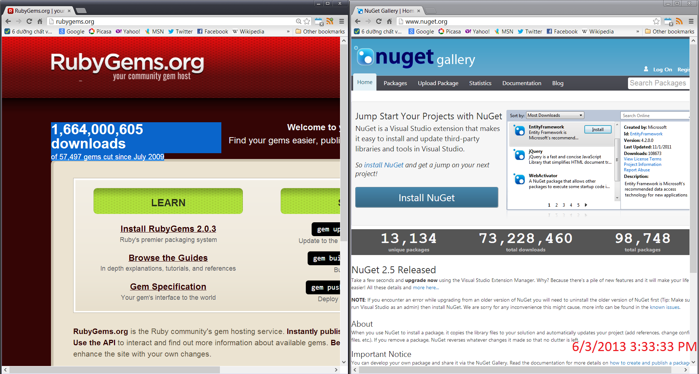
Some numbers

Slide 9
Create and Publish Nuget Package

Slide 10
Nuget Package Explorer
A Tool for Explore/Create and Publish Nuget packages
Download at
http://nuget.codeplex.com/releases/view/59864

Slide 11
Create you Nuget package
Step 1 : Compile your project and prepare the binary
Step 2 : Create a new local Package
Step 2.1 : Input package metadata/dependencies
Step 2.2 : Add the binaries
Step 3 : Publish the package

Slide 12
Create Your Own Repository

Slide 13
Create Your Own Local Nuget Directory
Step 1 : Create an empty folder
Step 2 : Copy your .nupkg into prepared folder
Step 3 : Add a Nuget source into Visual Studio’s configuration

Slide 14

Materials
Official Nuget documentation http://docs.nuget.org/
Scott Hanselman’s blog : http://www.hanselman.com/blog/IntroducingNuGetPackageManagementForNETAnotherPieceOfTheWebStack.aspx
Apress – Pro Nuget

Slide 15
Thank you

